Slide 1
What's New at Windsor Library?
Vicki Chavez, Adult Services Librarian

Slide 2
Sunday Hours
As of November 2022 we are open 7 days a week. Our hours are Sundays, 1 to 5 pm.

Slide 3
Borrowing Materials
Borrow books, music, movies, magazines – physical format or electronic.
Borrow a wide variety of items from our Library of Things – computers, cameras, parks passes and more.
We are Fine Free!
Return your materials late and you pay no fines.
Check out up to 100 items at time for 3 weeks.
Materials renew automatically up to 3 times, as long as they are not requested by another patron.

Slide 4
Great Programs
A result of Measure Y being passed in 2016, and with the assistance of the Friends of Windsor Library, we have been able to offer more terrific programs, including:
Tai Chi
3 Book Groups – Fiction/Nonfiction, Mystery and Nonfiction only.
Craft programs – painting programs, paper marbling, sewing, knitting, Master Gardeners, and more.
We have an upcoming program called Preventing Medicare Fraud on 3/25 at 11 am, and a 2-part Emergency Prep Help for Seniors program in April.

Slide 5
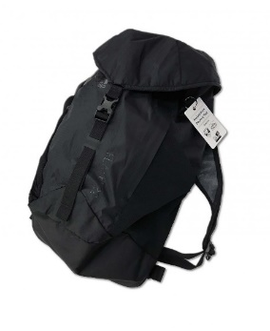
Regional Parks Discovery Pack and State Park Passes
Packs are available at each library branch and includes a backpack filled with:
a parking pass good at all 56 Regional Parks
a parks map
trail itineraries
hiking tips, wildlife guides, & other information to help them enjoy self-guided adventures in the parks.
This service is a partnership between Sonoma County Regional Parks, the Sonoma County Library.

Slide 6
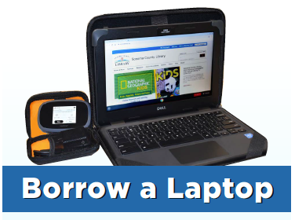
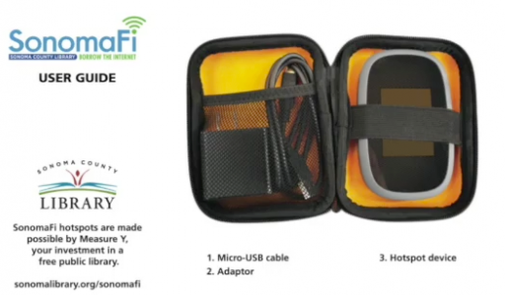
SonomaFi Hotspots and Chromebooks
Borrow a wifi hotspot or chromebook with a wifi hotspot for 3 weeks.
https://sonomalibrary.org/sonomafi
https://sonomalibrary.org/Chromekits

Slide 7
We offer a variety of camera equipment to use – cameras, tripods, camcorders, microphones and much more. You can borrow the items for one week. https://sonomalibrary.org/browse/libraryofthings/cameracatalog
Borrow Camera Equipment

Slide 8
https://sonomalibrary.org/browse/libraryofthings
Library of Things

Slide 9
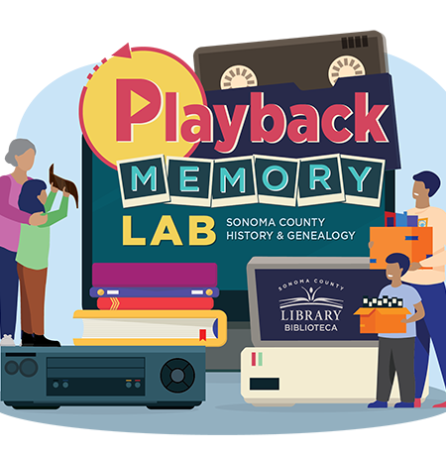
https://sonomalibrary.org/browse/libraryofthings/playback
A Do-It-Yourself space for you to preserve your personal, family and community history.

Slide 10
1. Kanopy 2. Libby 3. Hoopla 4. DMV Practice Driving Tests
Great Databases

Slide 11
Kanopy is a streaming movie collection that showcases more than 30,000 of the world’s best, classic, and groundbreaking films. Includes access to the Criterion Collection*, award-winning documentaries, film festival favorites, and foreign films. https://www.sonomalibrary.org/elibrary/a-z/kanopy

Slide 12
Libby, by Overdrive, is a digital platform that offers thousands of eBooks, eAudiobooks, comics and eMagazines in fiction and nonfiction. https://www.sonomalibrary.org/elibrary/a-z/libby

Slide 13
Stream digital media with hoopla Digital! Borrow comics, music, TV, movies, eAudiobooks, and eBooks in all genres and age groups. eBooks and audiobooks are available in English and Spanish. All checked items automatically return themselves. Over 980,000 titles are available, both fiction and non-fiction. https://www.sonomalibrary.org/elibrary/a-z/hoopla

Slide 14
Take DMV Practice Driving Tests from home. Review the California DMV Handbook, Commercial Driver Handbook, or Motorcycle Handbook online. Then take practice driving tests!
https://sonomalibrary.driving-tests.org/california/
DMV Practice
Driving Tests

Slide 15
Questions?
Windsor Regional Library
1020 Old Redwood Highway
Building 100
Windsor, CA 95492
Phone: 707-838-1020
Email: windsor@sonomalibrary.org
www.sonomalibrary.org

